Slide 1
Male vs Female review behavior on YELP
BY MARY-JANE, TOMISLAV AND AUKJE

Slide 2
Motivation & Summary Slide
Thesis: Yelp review behavior is impacted by whether you’re a male or female as well as where you by where you live.
In order to determine this the following questions need to be answered:
Are men and women perceived differently by their peers
Do men review restaurants different from women when it comes to the type of restaurants they review (cheap to expensive) and the ratings they give (1 to 5 stars)
How is review behavior related to local economical circumstances.
Answer for each question above in 1 sentence

Slide 3
Questions & Data
In order to answer the questions, the following datasources were used:
Three .json downloads containing data on YELP users, businesses and reviews (year 2000-2015)
One .csv file containing close to 70.000 names and their associated gender (male, female, both or unknown)
Two Yelp API’s (one with business data and one with review data
One census API containing data about …..

Slide 4
Data Cleanup & Exploration
Describe the exploration and cleanup process
Discuss insights you had while exploring the data that you didn't anticipate
Discuss any problems that arose after exploring the data, and how you resolved them
Present and discuss interesting figures developed during exploration, ideally with the help of Jupyter Notebook

Slide 5
Data Analysis
Discuss the steps you took to analyze the data and answer each question you asked in your proposal
Present and discuss interesting figures developed during analysis, ideally with the help of Jupyter Notebook

Slide 6
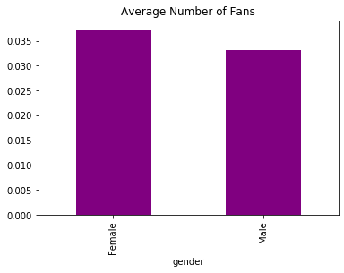
Gender and fanbase
Question:
Who has more fans on Yelp?

Slide 7
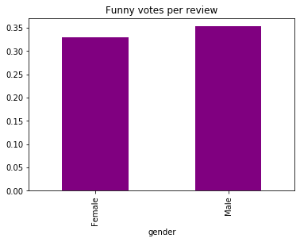
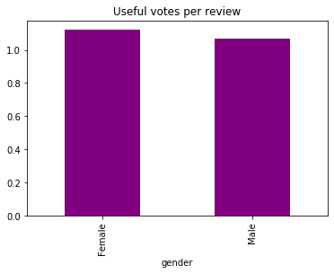
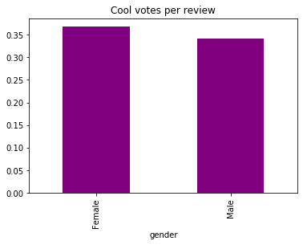
Gender and fanbase
Questions:
Who is more likely to have a funny review?
Useful review?
Cool review?

Slide 8
Q2 Data Cleanup & Exploration
Question 2: What types of restaurants do m/w review, how do they rate them.
Data flow:
get 44 St. Louis area zip codes > used excel to create .csv file incl. coordinates/zip code
find 20 businesses per zip code > Yelp API uses radius, so duplicate businesses were removed
find 3 reviews per business
link gender to each review > review names converted to first name only. If not in gender file > discard. If not male/female > discard
When trying to link the Question 1 data businesses to the Yelp API, business_id’s had all changed.
Possibly due to V2 vs V3 API versions. So a deeper dive with more current data wasn’t possible. Hence direct use of (current) API’s were necessary.
The business rating of $, $$, $$$ and $$$$ caused problems when being handles as index figures as well as labels in charts
Present and discuss interesting figures developed during exploration, ideally with the help of Jupyter Notebook

Slide 9
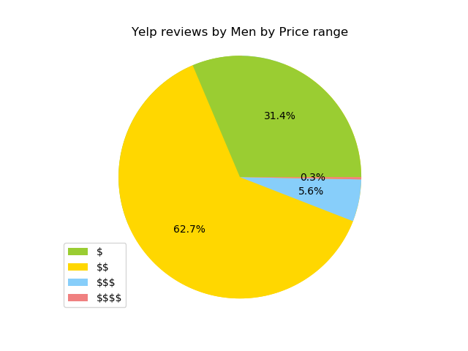
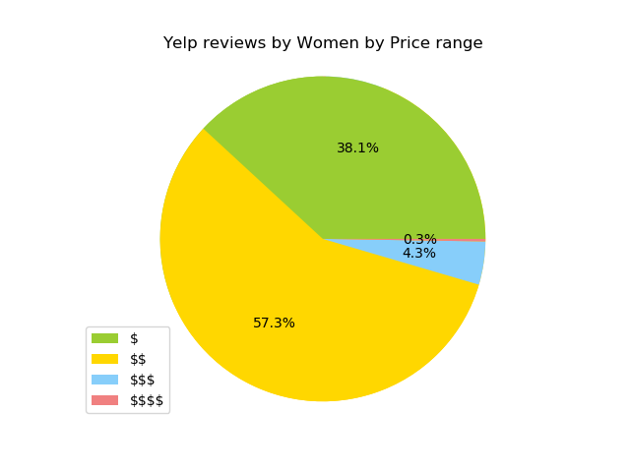
Q2 Results
338 men vs 378 women total, p=0.05164165

Slide 10
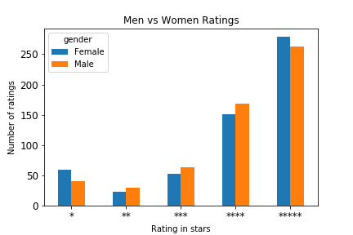
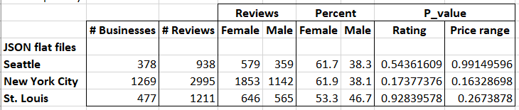
Q2 Results
338 men vs 338 women total, p=0.28132507

Slide 11
Post Mortem
Discuss any difficulties that arose, and how you dealt with them
Discuss any additional questions that came up, but which you didn't have time to answer:
What would you research next, if you had two more weeks?

Slide 12
Questions
Open-floor Q&A with the audience

